Slide 1
Dynamic Visuals
Aportfolio Design

Slide 2

Color Palettes
No more than three to four colors
Reflect yourself; reflect your major
How should the colors in this scheme be used? Why?
Notes:
More than three or four colors on a page can be distracting. Your page should mostly be one neutral or soft color with pops of bolder color. Use color to guide your readers eye to important information. The orange color in this pallet would draw a lot of attention, so it should be use sparingly. Similarly, the dark teal color may look black, or it may be difficult to discern, if used as a font.
Creative majors have more liberty with using bright, bold colors. However, the colors should still not be overwhelming. Business oriented majors should choose a sleek, elegant color pallet.

Slide 3
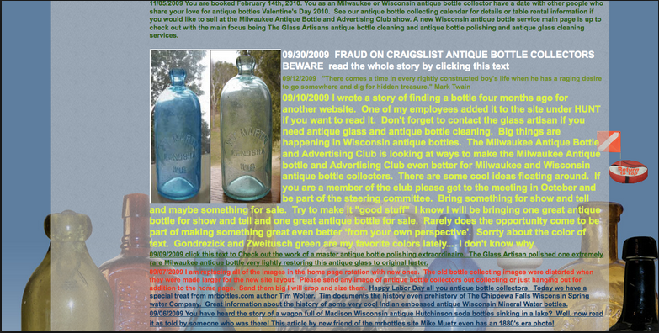

Color Palettes
Website #1
Website #2
Notes:
Which color palette is better? Why?
# 2 is clean and simple. It uses color to draw the eye to important information. Color is not overwhelming or distracting. Uses three simple colors.

Slide 4
Designing banners
First visual representation of your Aportfolio
Should reflect:
  Who you are
  What your Aportfolio is about
Remember this will be on every Aportfolio page.
Aportfolio Banner Tutorial

Slide 5


Designing Banners
Banner #1
Banner #2
Notes:
What can we tell from banner #1?
It says education, has four separate pictures relating to education
What can we tell from banner #2? What can we infer from the banner?
Not sure who this belongs to, we know they went to App State, maybe a photography major or minor

Slide 6
Background colors and images
Add visual depth to your Aportfolio
Based off of your color palette
Create a more dynamic, inviting Aportfolio
Aportfolio Background Color Tutorial
Aportfolio Background Image Tutorial
Notes:
If you use a color as your background, make sure to use the HEX codes in your color pallet to ensure matching colors. A HEX code is a code the computer uses to recognize which color you want. A HEX code should have a pound sign followed by a bunch of numbers.
When using a background image, it should be simple, clean, and not overly distracting. Your background image should convey something about who you are and the work you would like to do.

Slide 7
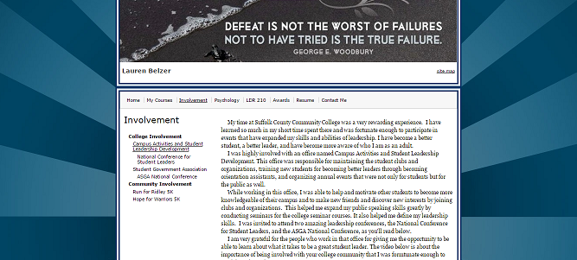
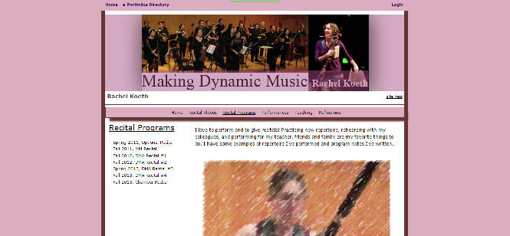
Background Colors and Images
ePortfolio #1
ePortfolio #2

Slide 8
Fonts
Limit the fonts you use to two or three:
  One for headers/titles
  One for subtitles/important text
  One for body text
This includes use of bold and italics.
Make fonts do the work for you.
Notes:
More than three fonts on a page is confusing. Limit yourself to only three fonts, each with a different purpose. If you need more variety in your page, use colors from your color pallet rather than an additional font.
Arial and Arial Bold are two different fonts and should not be counted as one font. However, using Arial, Arial Bold, and Arial Italics can create a dynamic page that is also flows nicely.
Use the fonts to draw attention to important text or important parts of the page. That way they do the work for you, and your reader can easily skim for important information.

Slide 9
Why write when you can show?
Writing should be concise and to the point
Provide visual representations of your writings
  Data or charts included in the paper
  Pictures
  Videos
  Drawings
  Infographics
  Quote in a colored text box
Use color and font variation to draw reader’s attention
Each page should have a visual element
Aportfolio pages should be no more than 200 words per page
Notes:
Each page should have some reflection or writing. However, your reader isn’t going to want to read the entire essay that you wrote.
Provide short quotes from your papers and write about what the paper is about as concisely as possible. Alternatively you can describe what you learned in writing your paper, or what you found challenging about the experience.
Use fonts and color to draw the readers attention to quotes or important information.
Think about when you visit a webpage. If it is nothing but writing are you really going to look at that page? White pages with text can be boring or seem overwhelming to readers. Each page should have some kind of visual element.
Writing concisely means taking the most important information and condensing it. You can always provide a link to an essay. If you have written well, the reader interest will be peaked and they will want to take a look at your essay. Try to keep each Aportfolio page to around 200 words.

Slide 10
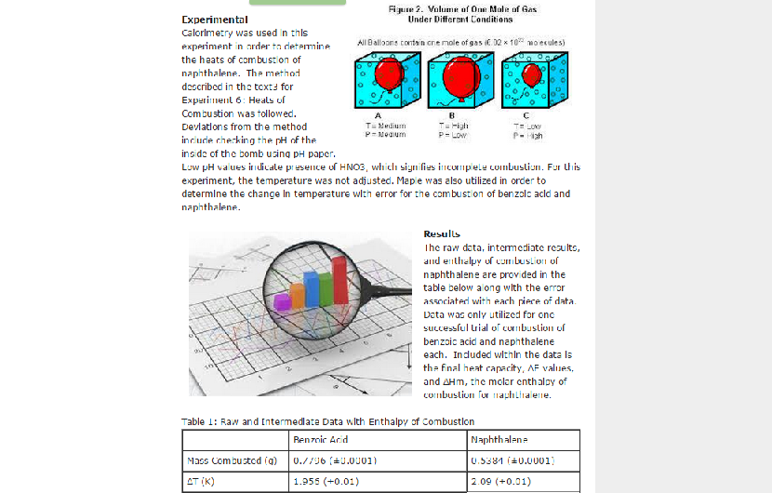
What visual elements do you see?
Notes:
Great use of pictures and tables to expand on her experiment. Use of color. Organization in paragraphs. Use of bold to help organize.

Slide 11
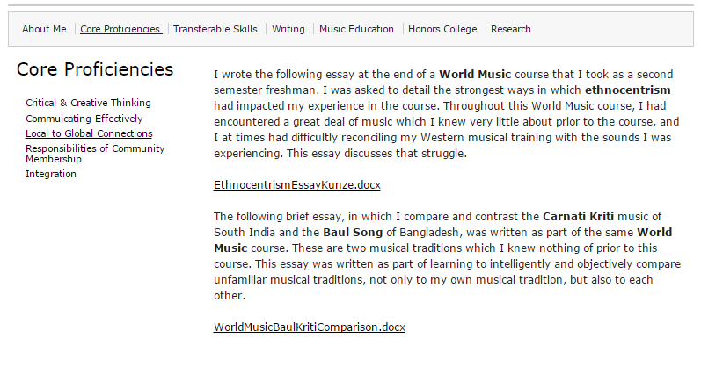
What visual elements do you see?
Notes:
Concise writing with link to the essay documents. Use of bold to draw reader’s attention to important information.

Slide 12
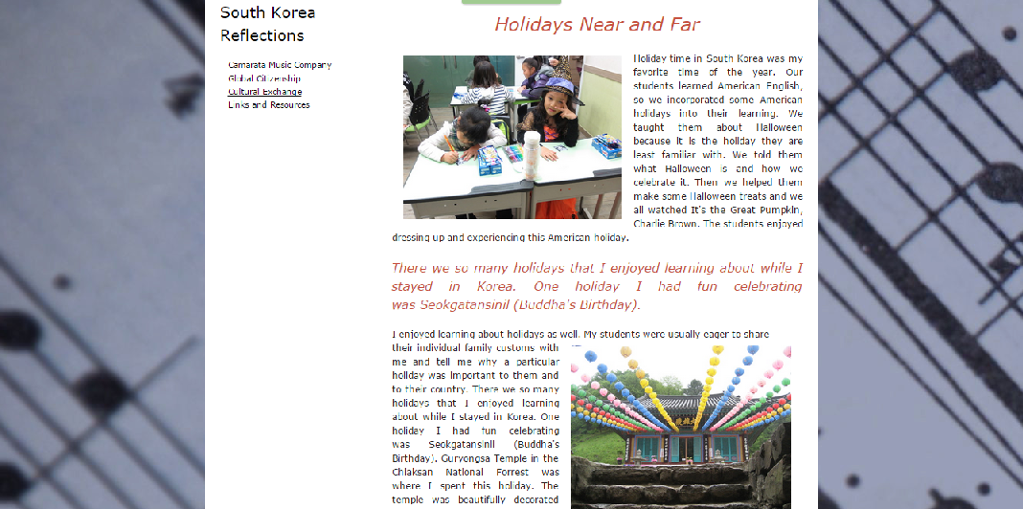
What Visual elements do you see?
Notes:
Use of background image, photos, font size and color used to highlight information.

